Slide 1
Fundamentals of Programming
Lecture #2

Slide 2
Basic C++ Programming Practice
  Finding Errors
    Syntax Errors
    Runtime Errors
  Heat Transfer Case Study
  Size of Data Types
  Practice Exercise 1
  Practice Exercise 2
  General Problems(Maths and Physics)

Slide 3
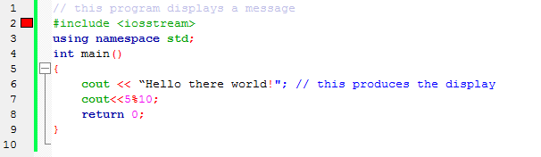
Syntax Errors
Code::Blocks shows errors using the red marker
  The top most error shows up first
  See error details in the log window

Slide 4
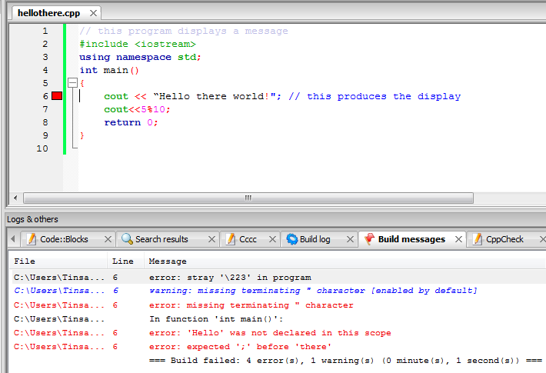
Syntax Errors
The first error is corrected, now it moves to the next error

Slide 5
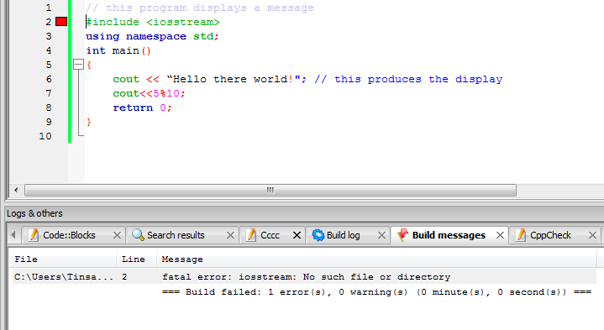
Syntax Errors

Slide 6
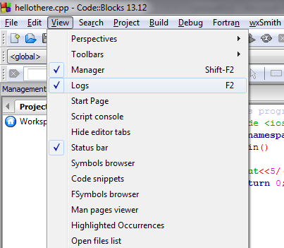
Can’t See Logs
If you can’t see the build messages, make sure the Logs is checked on View menu

Slide 7
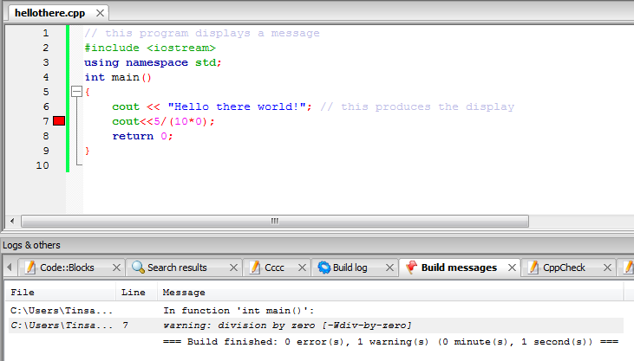
Run-time Errors
The Program will break and code::blocks shows you a warning for the next build

Slide 8
Case Study: Heat Transfer
In Lecture 1 you developed simple algorithm for the heat transfer problem
Finish the remaining steps
  Coding
  Testing

Slide 9
Size of Data Types
A unique feature of C++ is that you can see where and how values are stored
  sizeof() operator provides the number of bytes used to store values of the data type named in the parenthesis
  Values returned by sizeof() are compiler dependent

Slide 10
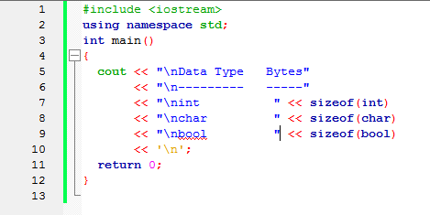
Size of Data Types

Slide 11
Practice Exercise 1
Using cout, write a C++ program that displays your name on one line, your id number on a second line, and your city, region, and phone number on a third line
Run the program

Slide 12
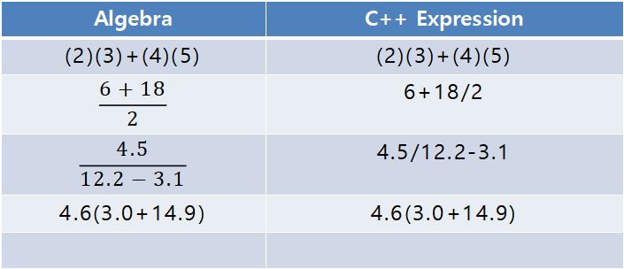
Practice Exercise 2
For the following correct algebraic expressions and corresponding incorrect C++ expressions, find the errors and write corrected C++ expressions in one C++ program
Algebra | C++ Expression
(2)(3)+(4)(5) | (2)(3)+(4)(5)
$$\frac{6+18}{2}$$ | 6+18/2
$$\frac{4.5}{12.2−3.1}$$ | 4.5/12.2-3.1
4.6(3.0+14.9) | 4.6(3.0+14.9)

Slide 13
Practice Exercise 2…
Write a C++ program that displays the results of the expressions
3.0*5.0,
7.1 * 8.3 - 2.2
3.2 / (6.1 * 5).
Calculate the value of these expressions manually to verify that the displayed values are correct.

Slide 14

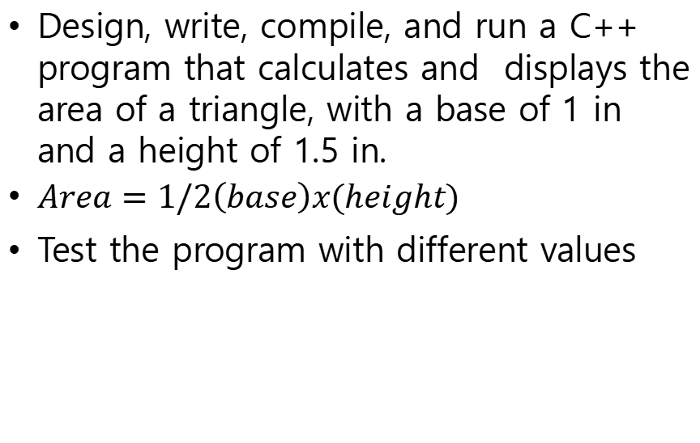
General Problems
Design, write, compile, and run a C++ program that calculates and displays the area of a triangle, with a base of 1 in and a height of 1.5 in.
$Area=1/2\left(base\right)x(height)$
Test the program with different values

Slide 15
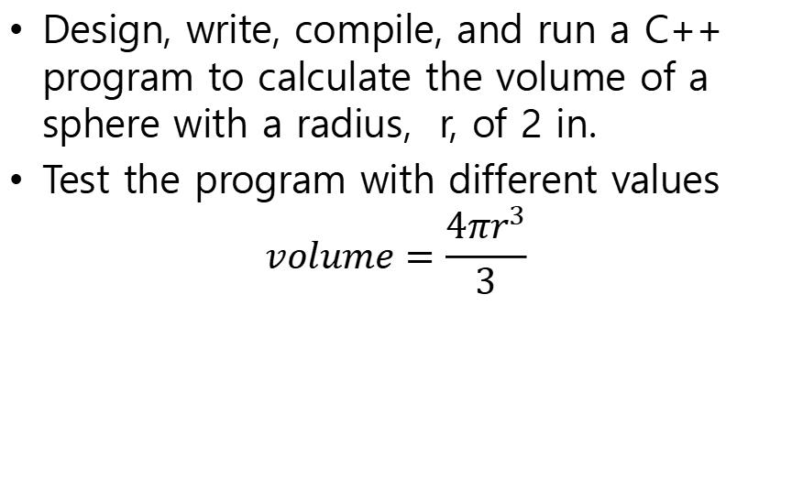
General Problems
Design, write, compile, and run a C++ program to calculate the volume of a sphere with a radius, r, of 2 in.
Test the program with different values
$$volume=\frac{4πr^{3}}{3}$$

Slide 16
General Problems
Design, write, compile, and run a C++ program to calculate the elapsed time it takes to make a 183.67-mile trip. This is the formula for computing elapsed time
    elapsed time = total distance / average speed
    The average speed during the trip is 58 mph.
Test it with different average speeds

Slide 17
General Problems
Write a program that accepts the value of temperature in Fahrenheit and converts to its Celsius equivalent. (hint C=F-32*5/9)
Test it with different temperatures

Slide 18

General Problems
Swap the contents of two variables using a third variable.
Swap the contents of two variables without using a third variable.

